Slide 1

Mathematical modelling and simulation of stress fibres in living cells Timothy Ryall Supervised by Dietmar Oelz University of Queensland
Notes:
Our research, that I will present today, is on the Mathematical modelling and simulation of stress fibers in living cells

Slide 2
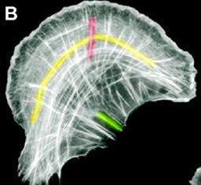
What are stress fibres?
Stress fibres in an animal cell, Sari Tojkander, institute of Biotechnology, Finland
Stress fibres allow a variety of different cells to move through expansion and contraction of the fibres
It is difficult to visualise how stress fibres contract
The aim of this research is to use modelling and simulation to gain insight on how this contraction occurs.
Stress fibres, Wei Wei Luo, Mechanobiology Institute, Singapore
Notes:
Stress fibres are contractile structures that are found in many non-muscle cells Consisting of dense bundles of microscopic filaments.
Stress fibres are used to generate cell movement through the expansion and contraction of their internal structure via the interactions between their filaments.
However, within stress fibres these structures are tightly packed and cannot be tracked using microscopic techniques.
Therefore, the aim of this research is to use modelling and simulation to gain insight on how the fibres are able to experience this contraction and hence facilitate movement.

Slide 3
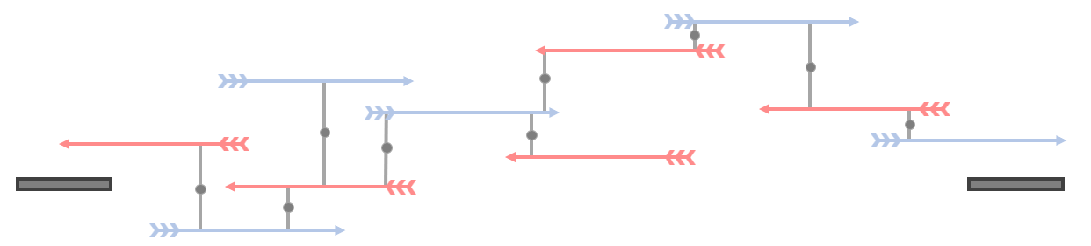
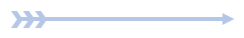
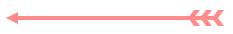
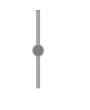
Model stress fibre
3 Key components of a stress fibre:
Actin filaments
Myosin motors
Focal adhesions
Positive filament
Negative filament
Notes:
To study these stress fibers we develop a 1D linear model of a stress fiber with 3 key components:
Actin filaments
Myosin motors
And focal adhesions.
Many studies have shown that these components are essential for stress fiber contraction, thus they are the core components of our model.
An example of our model is shown above including these three components.
The polarity of the filaments purely indicates the direction that the filament is facing.
Positive filaments have their pointed ends towards the right adhesion whereas negative filaments are pointed to the left.
\\
To explain our components in more detail we have:
Actin filaments. which make up the backbone of the stress fibre
They have a barbed end & a pointed end
Myosin motors. which move along the filaments controlling how the filaments move
And Focal adhesions. which are the end points of the stress fibre
These points are where the stress fibre grabs onto the cell's external environment

Slide 4
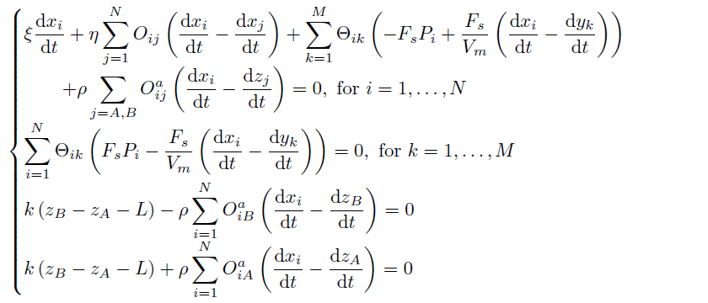
Agent based model
Using these ideas we present an agent based model (where we consider each individual molecular player) to simulate the fibres. This model is governed by a number of force balance equations.
Forces acting on filament i
of the N filaments
Forces acting on motor k
of the M motors
Forces acting on Focal adhesion A
Forces acting on Focal adhesion B
(Comino, 2022)
Notes:
Using these ideas we present an agent based model (where we consider each individual molecular player) to simulate the fibres.
This model is governed by a number of force balance equations.
The first equation governs the Forces acting on each filament i of the N filaments
The second governs the Forces acting on each motor k of the M motors
And the last two equations are the force balances of each of the two focal adhesion.
There are five main forces that are considered in this model

Slide 5
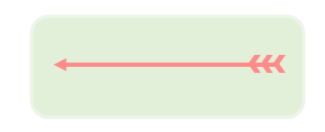
Five forces considered:
Cytoplasm viscosity
Frictional force opposes all filament movement
Forces acting on filaments
Forces acting on motors
Forces acting on Focal adhesion A
Forces acting on Focal adhesion B
Notes:
The first force we consider is The drag force due to the viscosity of the cells cytoplasm that the stress fiber resides in.
This force opposes all filament movements.

Slide 6
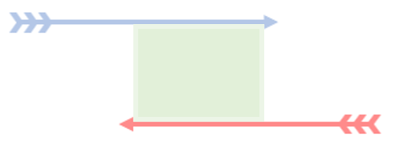
Filaments that overlap each other experience “friction”
Cross-linker friction
Forces acting on filaments
Forces acting on motors
Forces acting on Focal adhesion A
Forces acting on Focal adhesion B
Notes:
The second force we label cross-linker friction.
Within stress fibres there are proteins called cross-linkers that form and connect between overlapping filaments,
these proteins inhibit the movement of the filaments that they are attached to as they must be broken for the filaments to move away.
This leads to a ”friction” force between overlapping filaments.

Slide 7
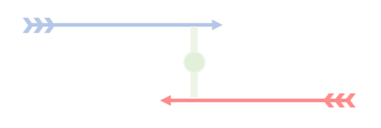
Force generated by motors as they move along filaments
Myosin motor force
Forces acting on filaments
Forces acting on motors
Forces acting on Focal adhesion A
Forces acting on Focal adhesion B
Notes:
Our third force is the force generated by the myosin motors as they travel along the filament pairs.
This is the main force that generates movement within the fiber.
The motor exerts this force on the filaments but also experiences the counteractive force itself.
Resulting in both the filaments and motors experiencing this force.

Slide 8
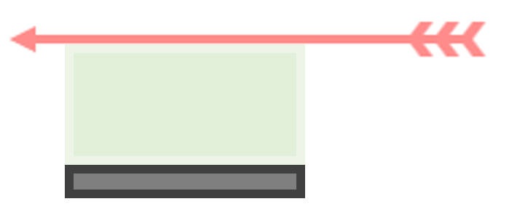
Filaments that overlap focal adhesions experience “friction”
Focal adhesion friction
Forces acting on filaments
Forces acting on motors
Forces acting on Focal adhesion A
Forces acting on Focal adhesion B
Notes:
The fourth force is the frictional force between filaments and focal adhesions.
Filaments that overlap focal adhesions experience a resistance as they climb out of the extracellular matrix, resulting in a frictional force between focal adhesions and overlapping filaments.

Slide 9
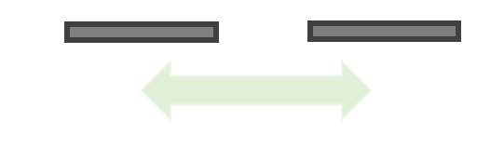
Focal adhesion spring force
Force to oppose stress fibre stretching or contracting
Forces acting on filaments
Forces acting on motors
Forces acting on Focal adhesion A
Forces acting on Focal adhesion B
Notes:
The fifth and final force is the focal adhesion spring force which is the force that opposes the expansion and contraction of the stress fiber and aims to keep the fiber at its equilibrium length L.
By utilizing these equations, we can begin to simulate the stress fiber

Slide 10
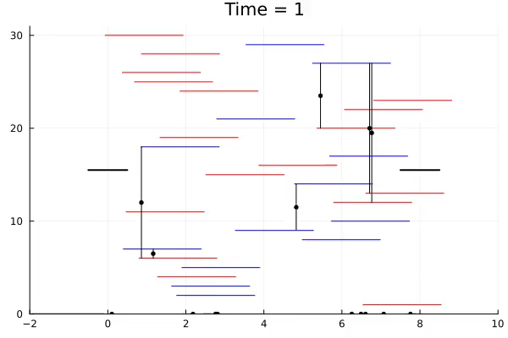
Example simulation
Notes:
Here we have a simulation of an example fiber and its interacting components.
The system of force balance equations show previously corresponds to an energy functional
We can use an energy minimization scheme within Julia to run simulations of the stress fiber and measure the forces experienced.
The force of interest to us is the contractile force of the fiber as we wish to understand how stress fibers are able to contract and thus facilitate movement as seen in nature.

Slide 11
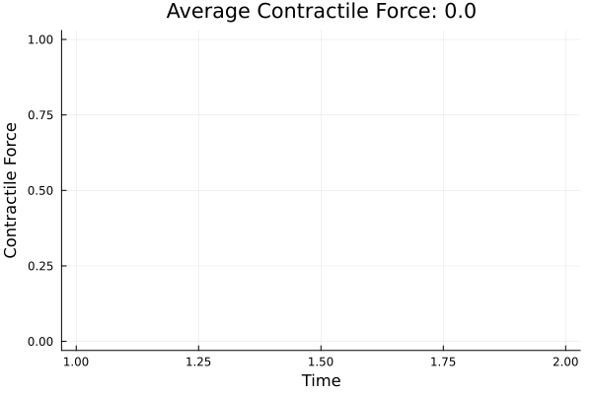
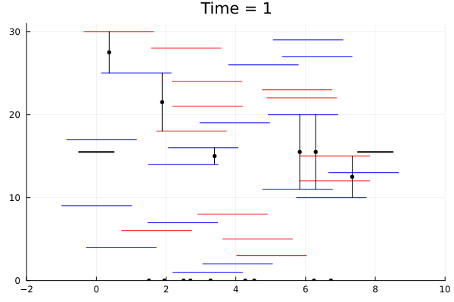
Initial simulations:
Expansion is favoured over contraction (Negative force ⇔ contraction)
(no. filaments) N = 30, (no. motors) M = 15
Notes:
Here is an example simulation along with a graph that represents the contractile force of the fiber in real time.
A negative force, when the graph is green, represents contraction of the fiber.
A positive force, when the graph is red, represents expansion of the fiber.
We can see here that expansion is greatly favored over contraction in this simulation.
\\
This trend of expansion being favored over contraction is not just the case in the example simulation but infact was consistent across all the initial simulations.
So the question is:
What additional special interaction do these filaments and motors have to generate the contraction seen in nature? Since in the current working model expansion is always favoured.
To understand and tackle this problem, we will look at how the filaments and motors move, and how their interaction results in the contraction and expansion of the fibre.

Slide 12
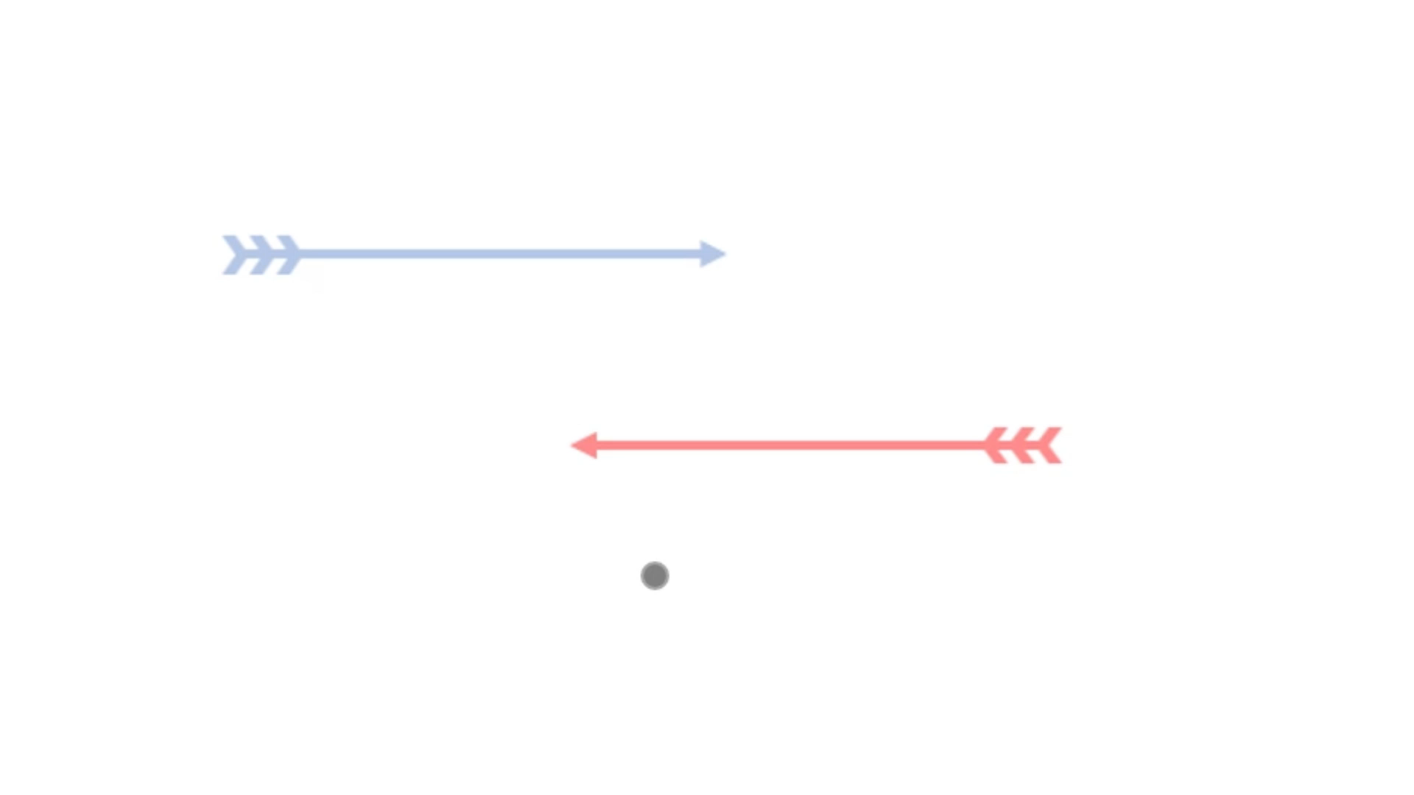
Filament and motor movement
Motors attach to 2 overlapping filaments
The motor moves to the barbed ends of both filaments
When the motor reaches one of the barbed ends it will drop off
Notes:
In our current simulation myosin and filament movement is modeled off how they are observed to move in nature.
There are three main steps to their interaction in our simulation:
First the motor will attach to 2 overlapping filaments
Second. the motor will move towards the barbed ends of the filaments
Finally when the motor reaches one of the barbed ends it will drop off

Slide 13
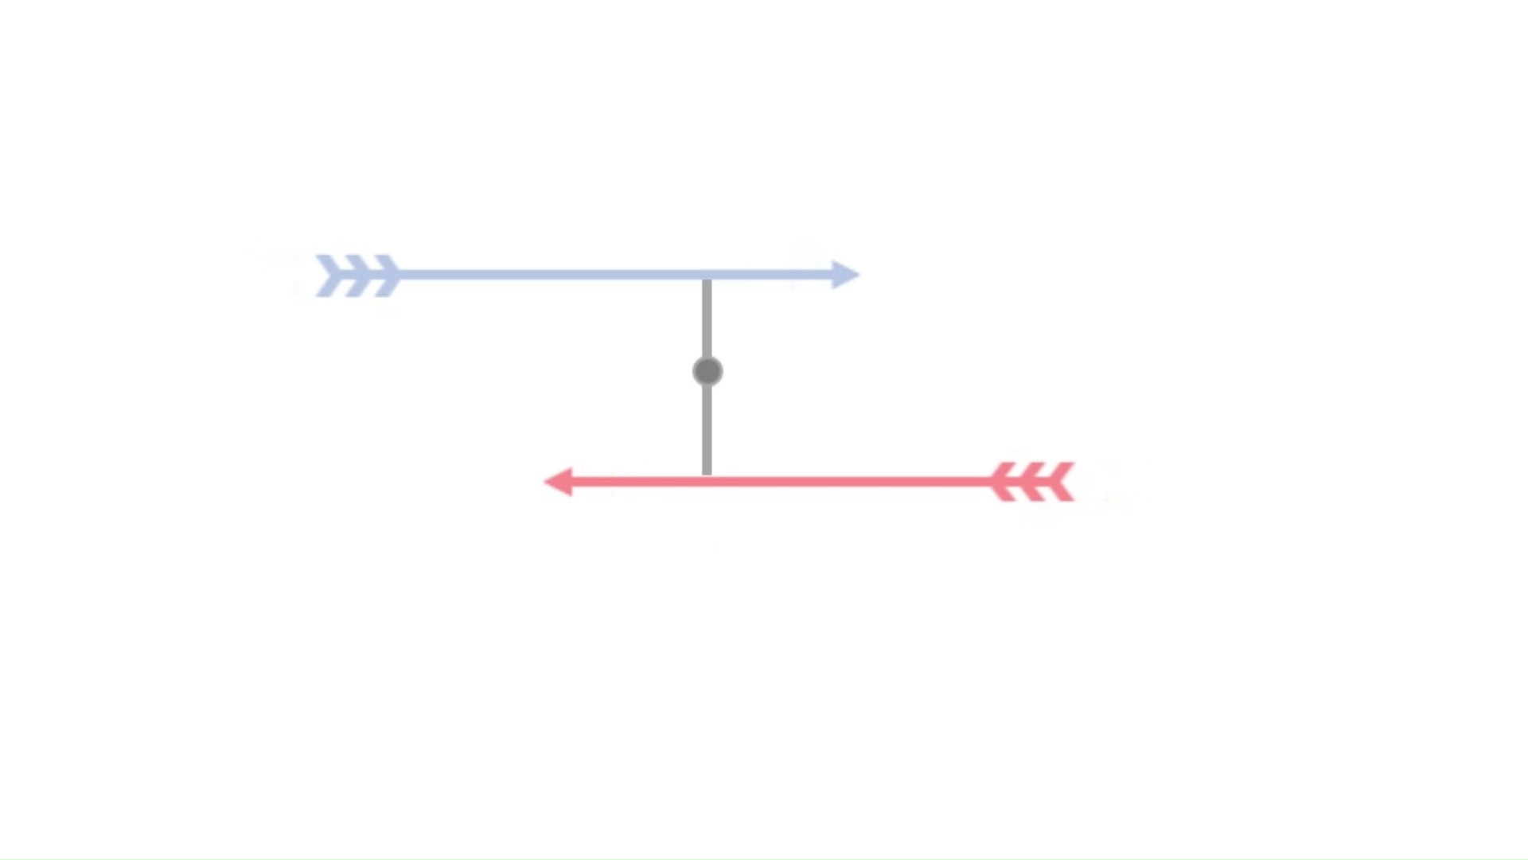
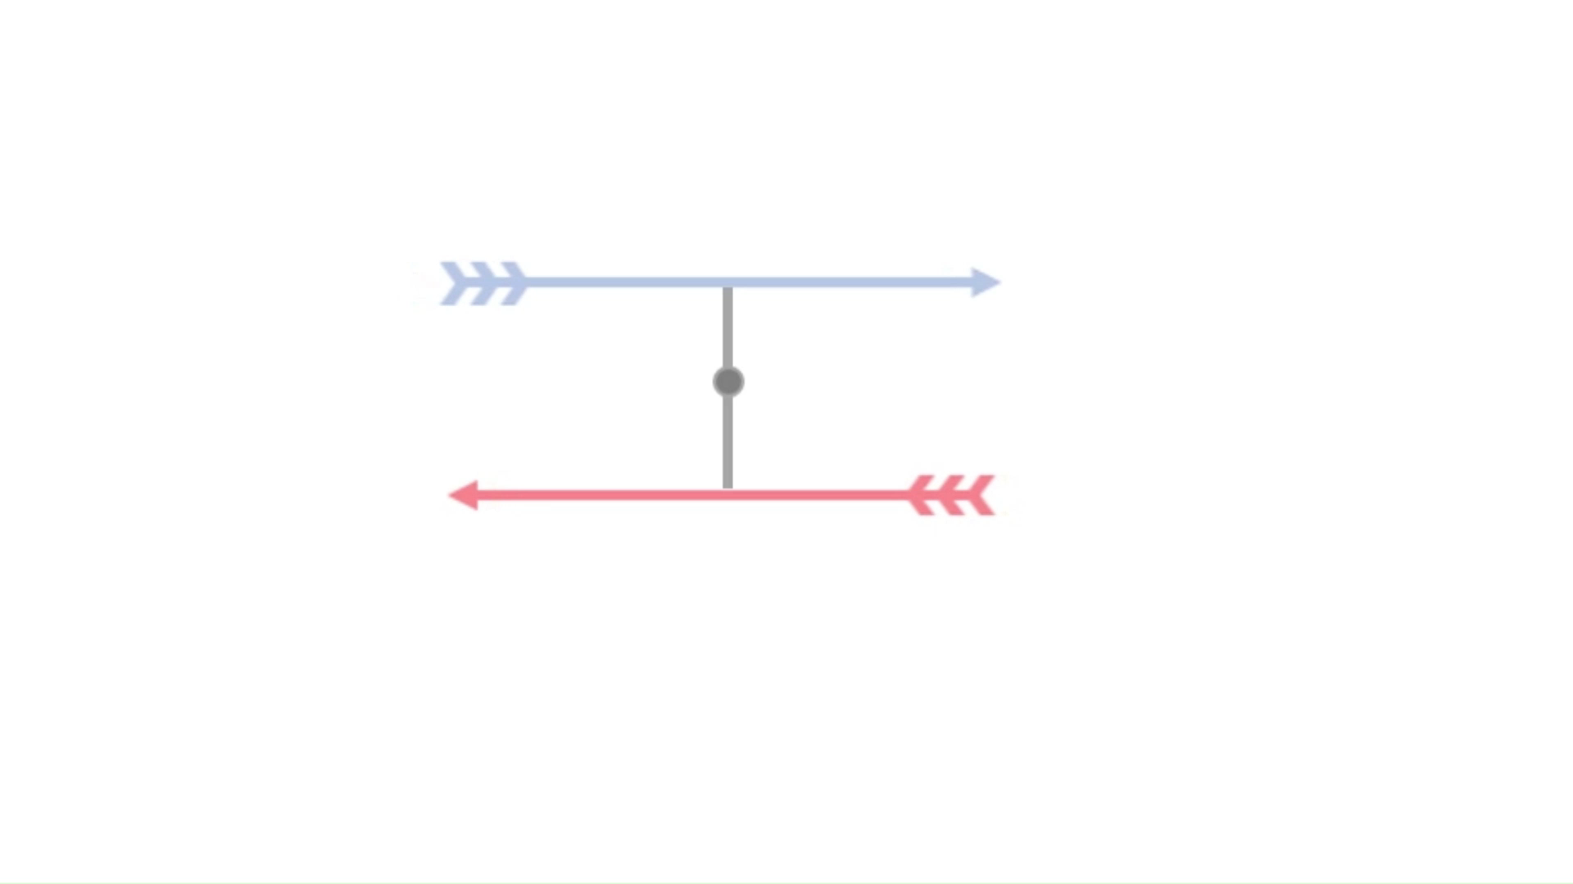
When does contraction occur?
After a motor attaches to a filament pair there are 2 phases:
the contraction phase
the expansion phase
Since motor attachment can be anywhere along the filament pair, the motor will in general spend more time in the expansion phase
Contraction phase
Expansion phase
Motor is between the attachment point and the centre of the filaments
Motor is between the centre and the barbed ends of the filaments
Notes:
To tackle the problem of expansion seen in the simulations we must consider when contraction actually occurs.
After a motor attaches to a filament pair there are 2 phases: the contraction phase and the expansion phase.
The contraction phase is when the motor is between the attachment point and the centre of the filaments.
And the expansion phase is when the motor is between the centre of the filaments and the barbed ends of the filaments.
\\
However, the motor can attach anywhere along the filament pair.
Therefore the distance between the attachment point and the centre will always be shorter than the distance between the centre and the barbed end.
This means that the motor will always spend more time in the expansion phase.
Resulting in expansion bias

Slide 14
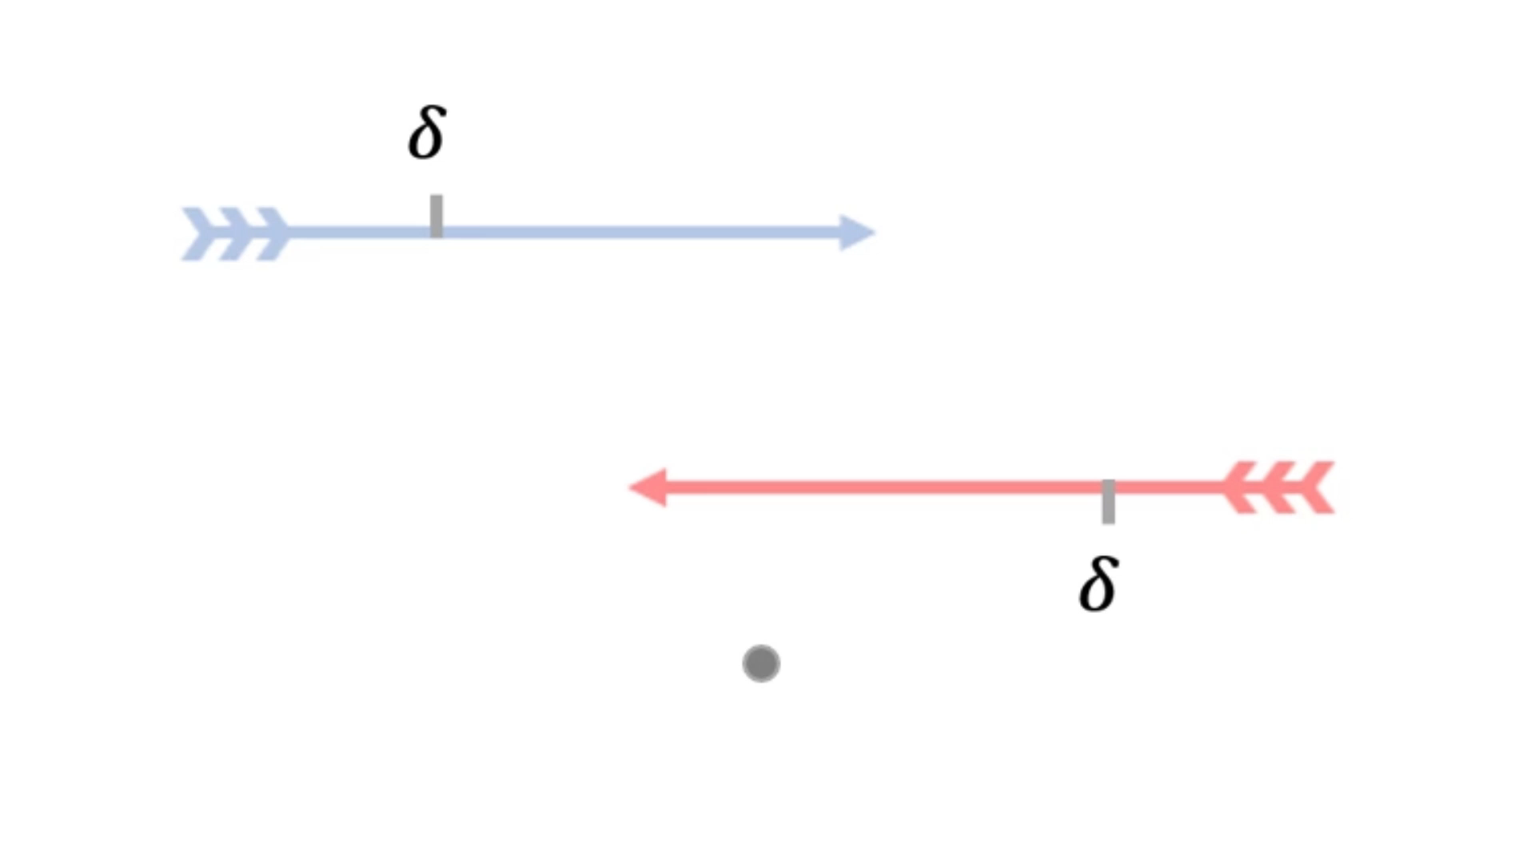
Proposed solution
We propose a solution to the contraction problem:
Early motor drop offs
We have motors drop off a distance 𝛿 away from the barbed end
This will shorten the expansion phase
increasing overall contraction
Notes:
So we propose a solution in an attempt decrease the expansion bias.
This new features is: early motor drop-offs.
By implementing this feature we slightly change how the motors and filaments interact.
With early motor drop offs instead of having our motors drop off at the barbed end of the filaments, we have them drop off a distance 𝛿 away from the barbed end.
This will shorten the expansion phase and should increase overall contraction.

Slide 15
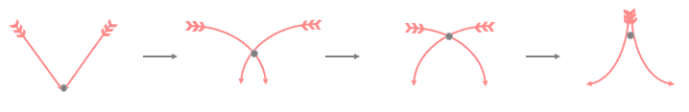
Origins of early motor drop-offs
This stems from a paper on flexible actin filaments (Tam, 2022):
Tam showed that as myosin travels along the filaments, the filaments buckle
Resulting in the motor to dropping off early before reaching the barbed ends.
Notes:
The concept of early motor drop offs stems from Tam's paper on flexible actin filaments.
Which showed that as myosin travels along the filaments, the filaments buckle causing the motor to drop off early before reaching the barbed ends.
Thus in our 1D version of the model we propose that the filaments have a point at which the motor will drop off and become inactive

Slide 16

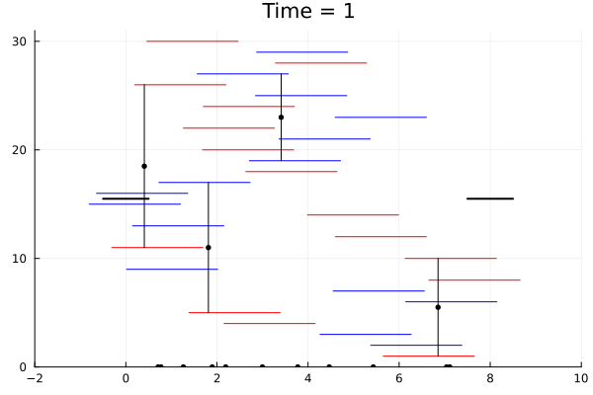
After implementing early motor drop-offs:
Contraction is greatly improved (Negative force ⇔ contraction)
Example above is using 𝛿 = 1 (filament length = 2)
Notes:
We can now run simulations with the newly implemented early motor drop offs.
Remembering, that negative force on the graph, represented in green, indicates contraction.
We see that these simulations show that contraction is greatly improved after the implementation of this interaction.
To determine the effectiveness of early motor drop-offs we can now run simulations at different drop off distances to determine the effect on contractility.

Slide 17
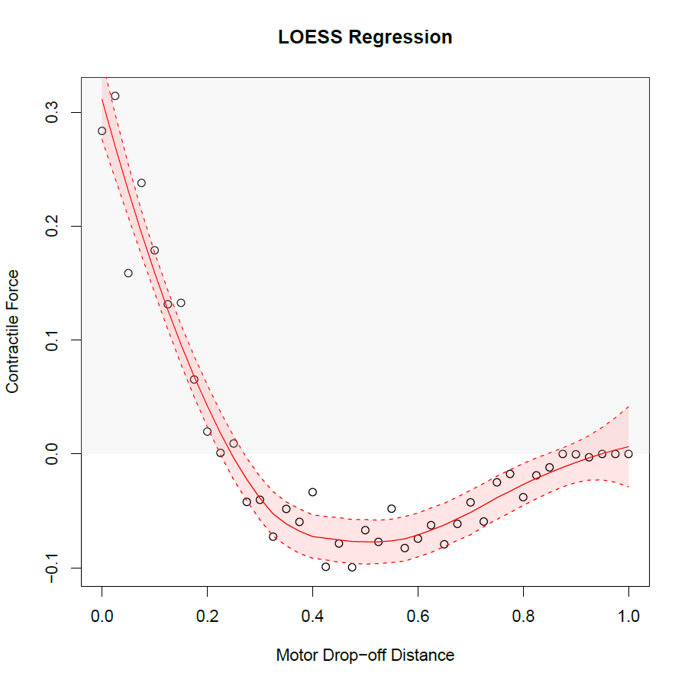
Relationship between Motor drop offs and Contraction
With filaments of length l = 1
Can we develop an equation for this relationship?
Will it match simulation results?
To do this we covert to a fluid-type continuum model
Notes:
This graph shows the simulated relationship between motor drop off distance and time average contractile force experienced by the fibre.
For example fibres simulated with a motor drop off distance of 0.5 will on average experience a contractile force of -0.1 and therefore contraction
Where as fibres simulated with a motor drop off distance of 0.2 will on average experience expansion
Our next question is:
Can we develop an equation that gives us the relationship between motor drop-off distance and contraction.
That is, can we compute a closed form expression for effective contractile force.
And does this solution match the relation seen in the experimental simulation results
To do this we covert from our agent based model to a fluid-type continuum model.

Slide 18
Convert from agent based to continuum model
Instead of considering interactions between each individual filament
We consider the groups of filaments and motors as fluid type substances.
Notes:
We convert from the perspective of considering the interactions between each individual filament
and instead consider the groups of filaments and motors as fluid type substances.
In this model we work in the regime where actin filaments are short - and their abundance large.
For example, when transitioning from our agent based model to continuum model:
Instead of considering The position of each motor along the fibre
We now consider The density of motors at each point along the fibre.,

Slide 19
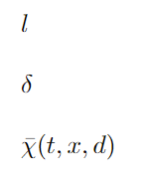
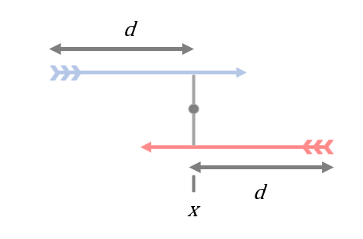
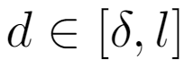
Features of the model
We define several quantities; the important ones are as follows:
Denotes the length of the actin filaments
Denotes motor drop-off distance
Represents the density of motors
at position x and time t
that are connected filaments where barbed ends are distance d away from x
Notes:
We define several quantities in our model. The ones that will be important to us today are:
L: which denotes the length of the actin filaments
Delta: which denotes the motor drop off distance
And Chi Bar: which takes three parameters, t, x, and d
and represents the density of motors at position x and time t that are connected to anti parallel Actin filaments where both of filament's barbed ends are distance d away from x

Slide 20
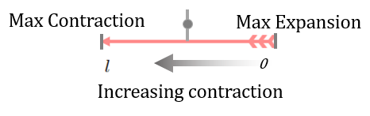
First model for contractile force
When myosin towards pointed end → contraction
When myosin towards barbed end → expansion
Therefore we can construct model using average myosin position to predict contractile force.
Notes:
We develop our first model for contraction by considering how myosin position relates to contractile force.
As we discussed previously: myosin towards the pointed end results in contraction and myosin towards the barbed end results in expansion.
We can therefore observe that as average position of myosin moves from barbed end “0” to pointed end “l” contraction increases.
Therefore we can construct model using average myosin position to predict contractile force.

Slide 21
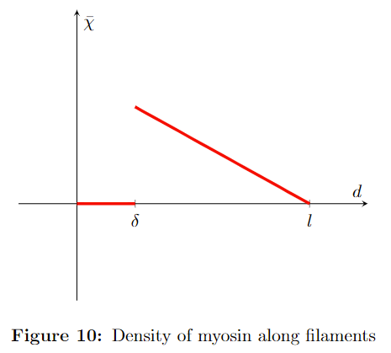
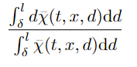
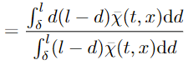
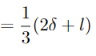
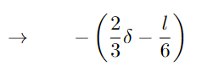
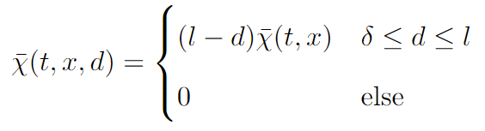
Average myosin position
We take expected value of myosin position along the filament pair and normalise it.
Translating to measure contraction
Notes:
To calculate the average position of myosin we take expected value of myosin position along the filament pair and normalise it.
To simplify this equation, and preform the second step in the above working, we must consider the density of myosin along the filaments:
We see that the density of myosin along a pair follows the above distribution.
This distribution is due to the fact that myosin can attach at any point along the pair between the pointed end of the filaments “L” and the motor drop off point “delta” therefore attachment is uniform with in this interval.
However, myosin only moves towards the barbed end of the filaments over time resulting in myosin density accumulating near “delta” and moving away from the pointed end “L”.
\\
By taking the average myosin position and translating it we can determine the following model for contraction.
It can be noted that the model predicts that contraction occurs when motor drop off distance, delta, is greater than L over 4

Slide 22
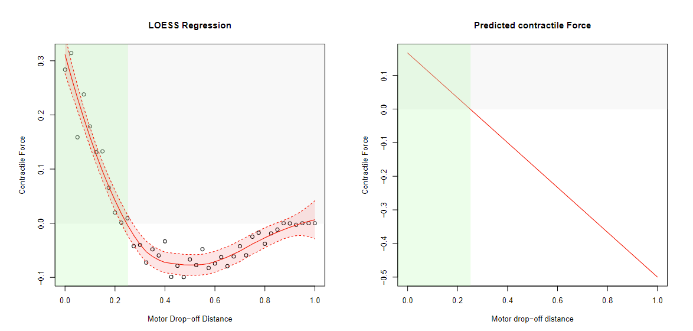
First model
Comparing our model with the simulation data we have:
Correctly predicts the region of contraction
As 𝛿 becomes large the model’s fit to the simulated relationship deviates
The green region is the region of expansion predicted by the model
Notes:
Comparing our first model to the simulated data and highlighting the region of predicted expansion green
we can see that the model correctly predicts the region of contraction seen in the simulated data.
However, as delta becomes large the models fit to the simulated relationship deviates.

Slide 23
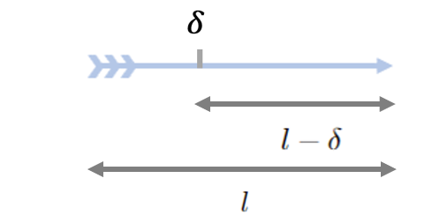
Second model for contractile force
We now additionally consider the proportion of active myosin
As 𝛿 increases the width of a filament that myosin can attach to decreases.
Resulting in less active myosin motors.
Means less force exerted within the fibre.
Notes:
To improve our model, we now consider the additional factor of the proportion of active myosin.
Myosin can attach to filaments anywhere between the pointed end and delta.
This width of attachment is therefore equal to L - delta
Therefore as delta increases the width of a filament that myosin can attach to decreases.
Which means that less myosin is able to attach.
Resulting in less active myosin motors.
Less active motors means less force exerted within the fibre.
It is clear, this factor is relevant to the contractility of the fiber especially as delta gets large

Slide 24
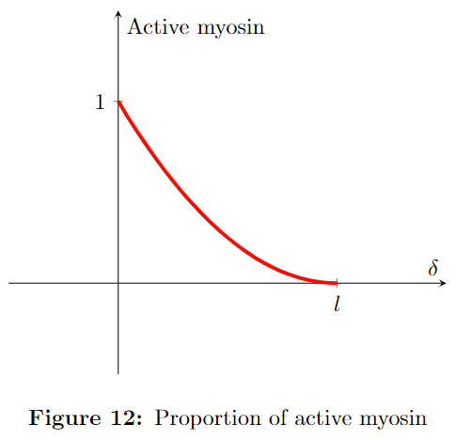
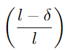
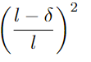
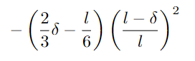
Proportion of active myosin
The probability of motor attachment
The proportion of motors that will attach to two filaments and is therefore active is given by
Incorporating this new factor gives:
Notes:
Therefore to find the proportion of active myosin we first consider that the probability of a motor being able to attach an overlapping filament is given by
The width of attachment “L - delta” over the width of the filament “L”.
We therefore find that the proportion of motors that will attach to the two filaments and will therefore be active is given by the square of the above probability.
\\
By incorporating the additional factor of active myosin proportion with our original model we can now present our new model for contraction.

Slide 25
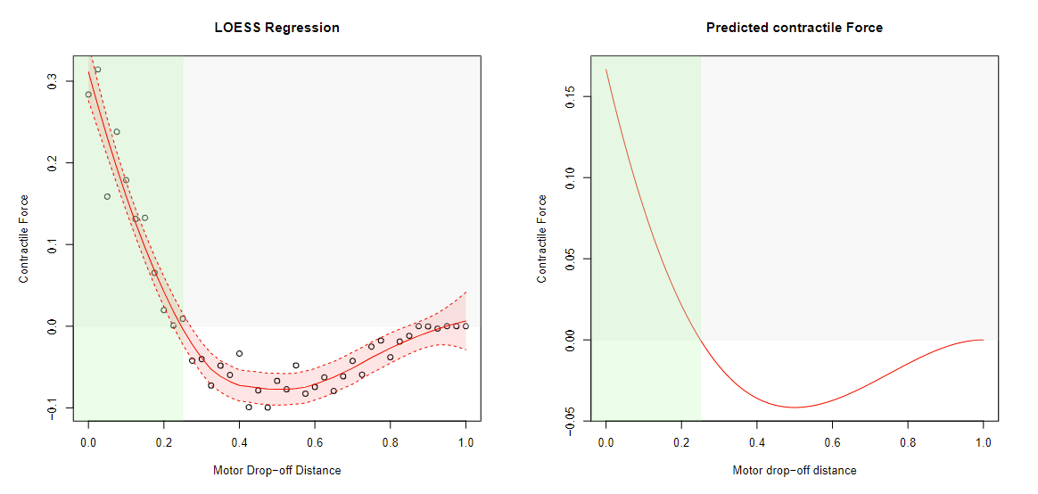
Second model
Comparing our model with the simulation data we have:
Models alignment is improved over the initial model especially for large 𝛿
The green region is the region of expansion predicted by the model
Notes:
By now comparing our new model to the simulated data
We find that the models alignment is improved over the initial model especially for large delta
However, the scaling is not accurate due to the fact that we have not accounted for dimensional constants. Which should be investigated with further research.

Slide 26

Notes:
Thankyou for your time today.

